Slide 1

Networks Flows

Slide 2
One often graphs to model transportation networks - networks whose edges carry some sort of traffic and whose nodes act as “switches” passing traffic between different edges.
Eg-
1) a computer network in which the edges are the links that carry packets and the nodes are switches
2) a fluid network in which edges are pipes and that carry liquid, and the nodes are junctures where pipes plugged together
The network models of this category have several ingredients: capacities on edges, including how much they can carry; source nodes in the graph, which generate traffic; and the traffic itself which is transmitted across the edges.

Slide 3
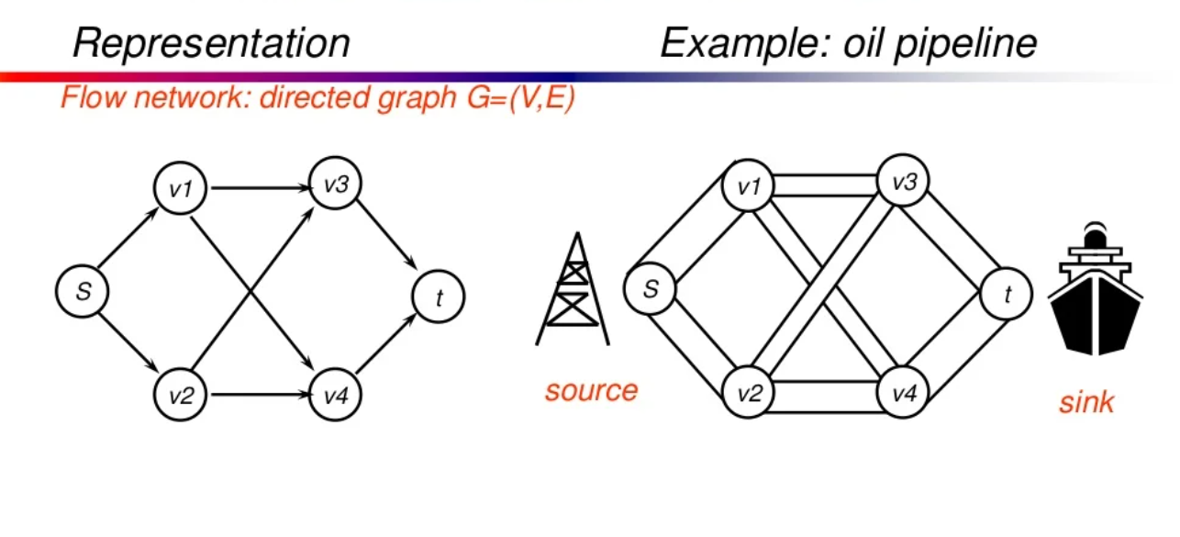

Slide 4
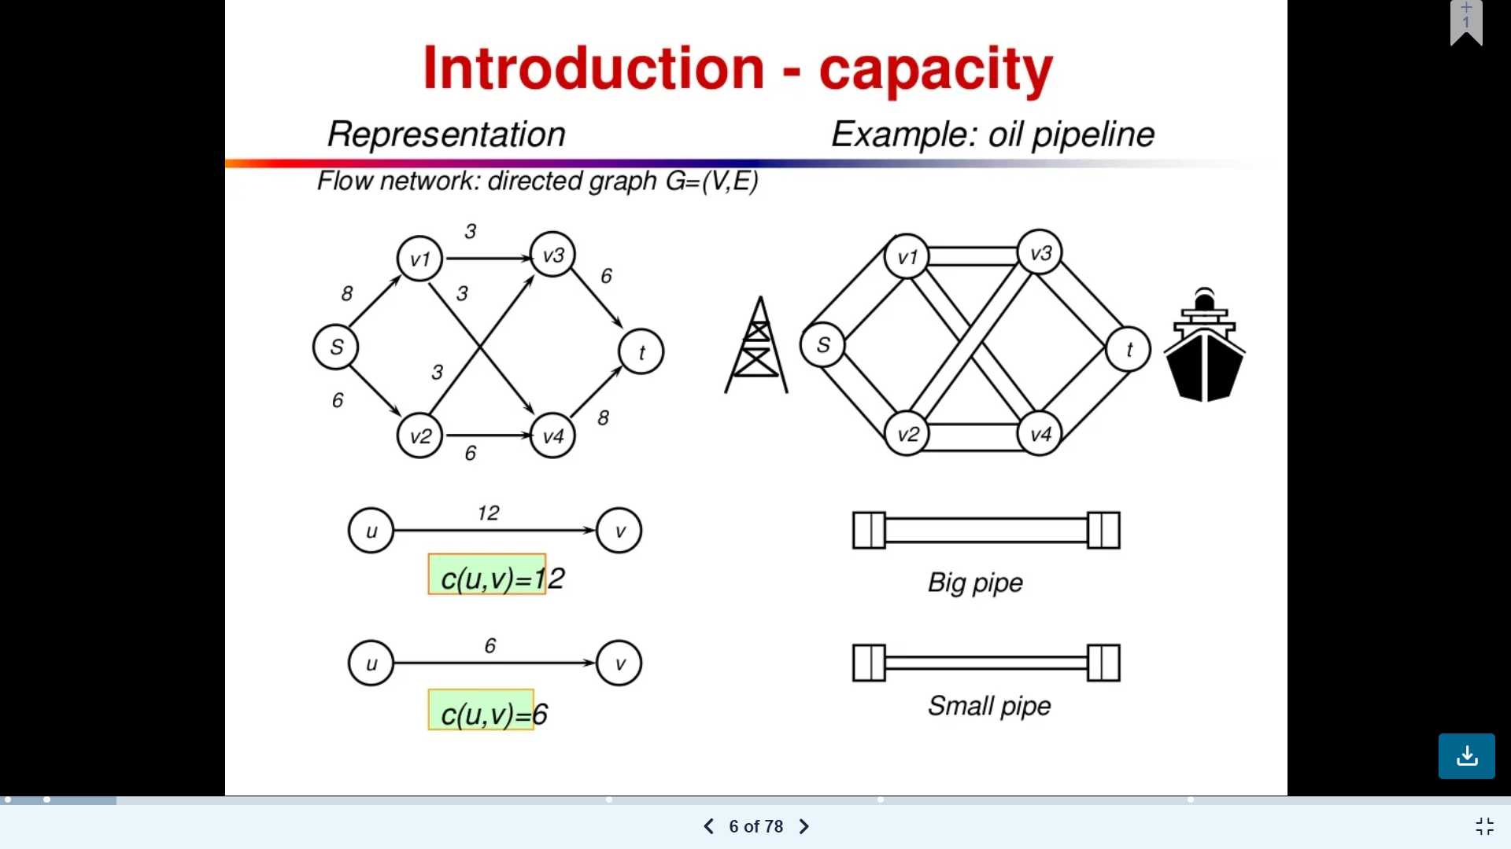
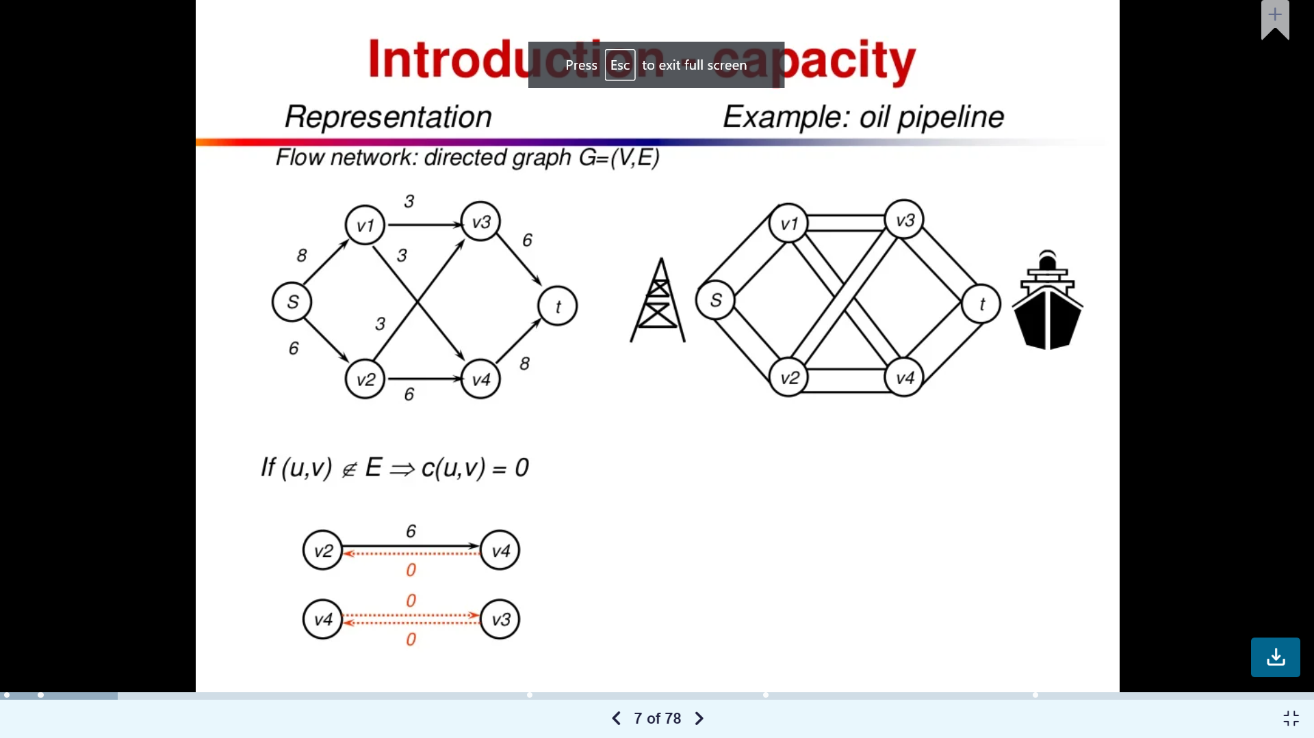

Slide 5
Network flow
Networks are important for both electronic communication and for transport of goods.
The problem of efficiently moving entities (such as bits, people, or products) from one place to other in an underlying network is modeled by network flow.

Slide 6
Flow network.
A flow network G = (V, E) is a directed graph, with two specially marked nodes, namely a single source node s ∈ V and single sink node t ∈ V .
The s, t are called internal nodes.
In addition, there is a capacity function c : V × V → R that maps edges to positive real numbers.
we shall make some assumptions:
no edge enters the source s, and no edge leaves t, and
there is at least one edge incident on each node.

Slide 7
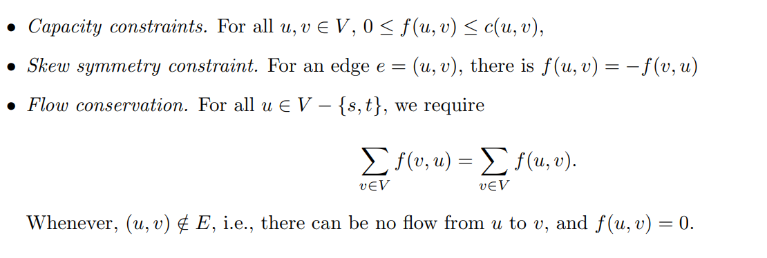
Flow.
An s-t is a function f : V × V → R. The value f(u, v) is amount of flow in edge (u, v). A flow function is required to satisfy the following constraints:

Slide 8
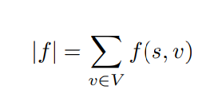
`
The capacity constraint says that the total flow on an edge does not exceed its capacity.
The skew symmetry condition says that the flw on an edge is the negative of the flow in the reverse direction.
The flow conservation constraint says that the total net flow out of any vertex other than the source and sink is zero.
The value of this of net flow from s defined as :
In the maximum-flow problem the objective is to find a flow function that satisfies the three constraints, and also maximizes the total flow value |f| from source s.

Slide 9
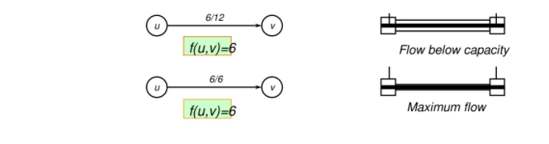

Slide 10
Maximum flow problem
Given a graph G with a source S and sink T,we wish to find flow with maximum value
Capacity constraints say that the flow from one vertex to other must be nonnegative and must not exceed the given capacity
Flow consetvation property says that total flow into a vertex other than source or sink must equal to the total flow out of that vertex
Flow in equals flow out

Slide 11
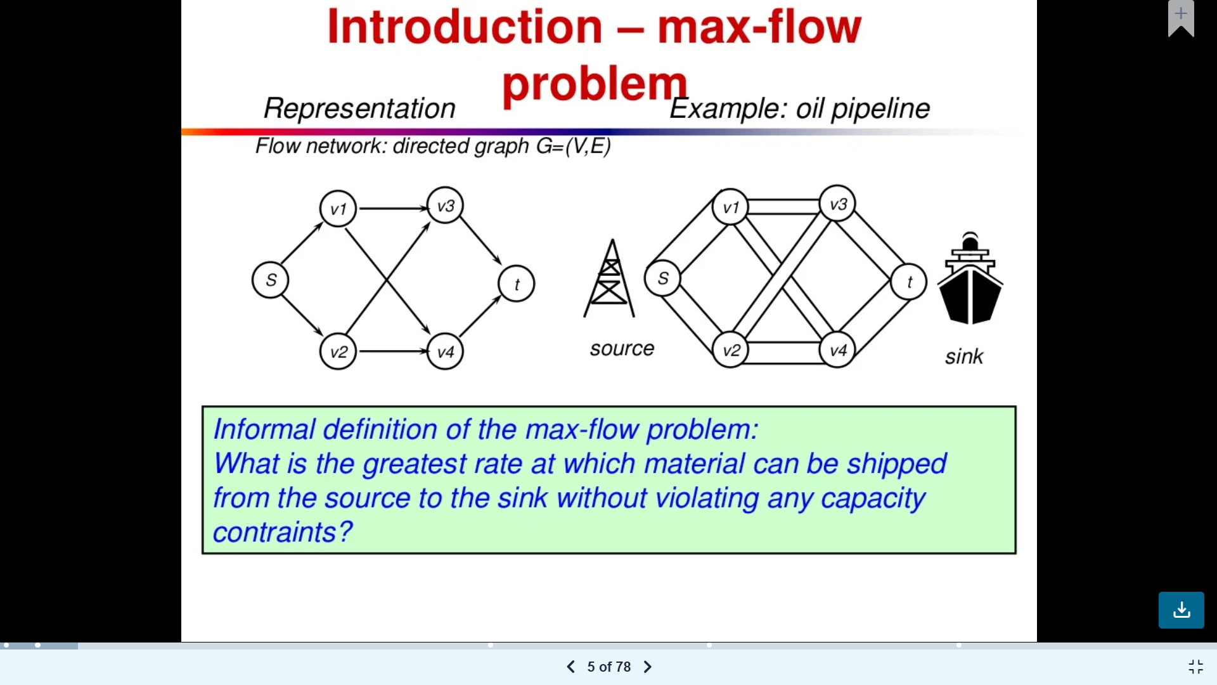

Slide 12
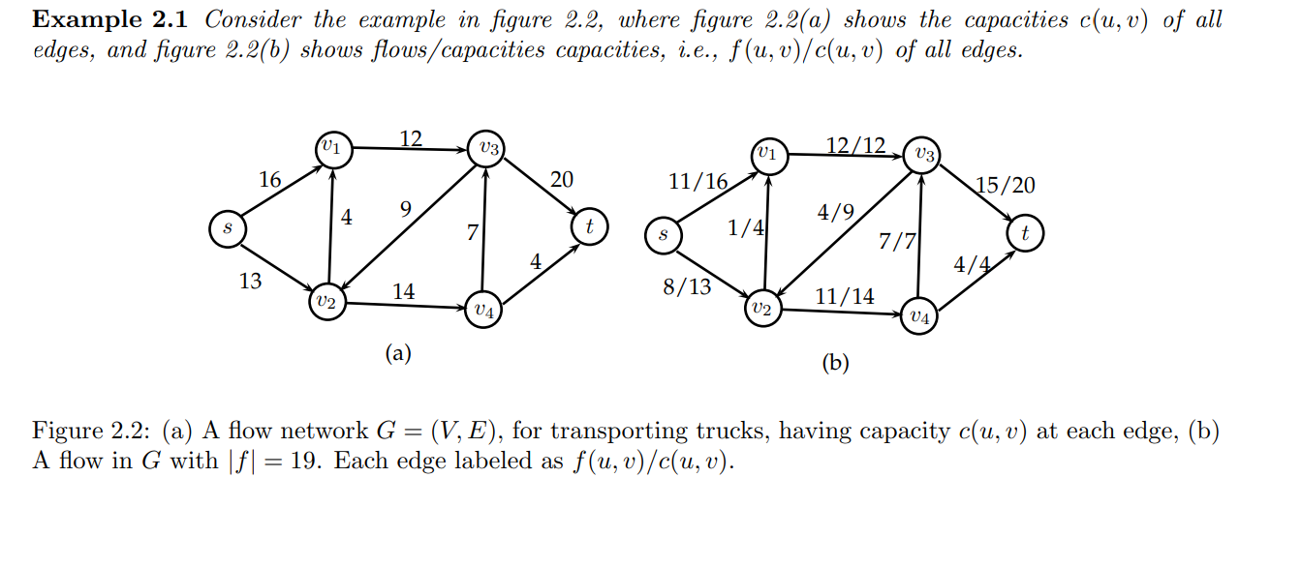

Slide 13
s-t cut( cut (S, T) )
An s-t cut of the graph is partitioning of the vertex V into two sets S and T = V − S such that s ∈ S and t ∈ T .
That is, an s-t cut is a division of the vertices of the network into two parts, with the source in one part and the sink in the other.
The cut-set of a cut C is the set of edges that connect the source part of the cut to the sink part:
Thus, if all the edges in the cut-set of C are removed, then no positive flow is possible, because there is no path in the resulting graph from the source to the sink.

Slide 14
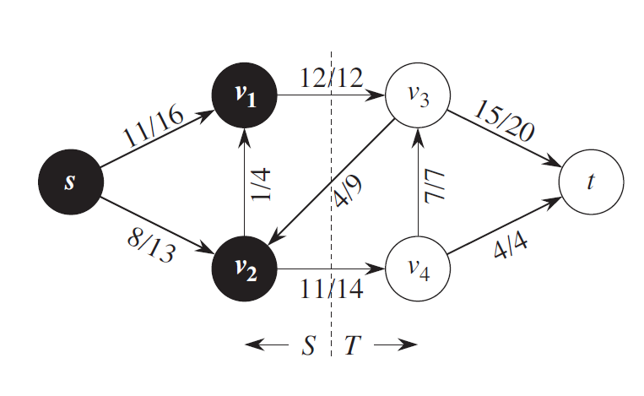

Slide 15
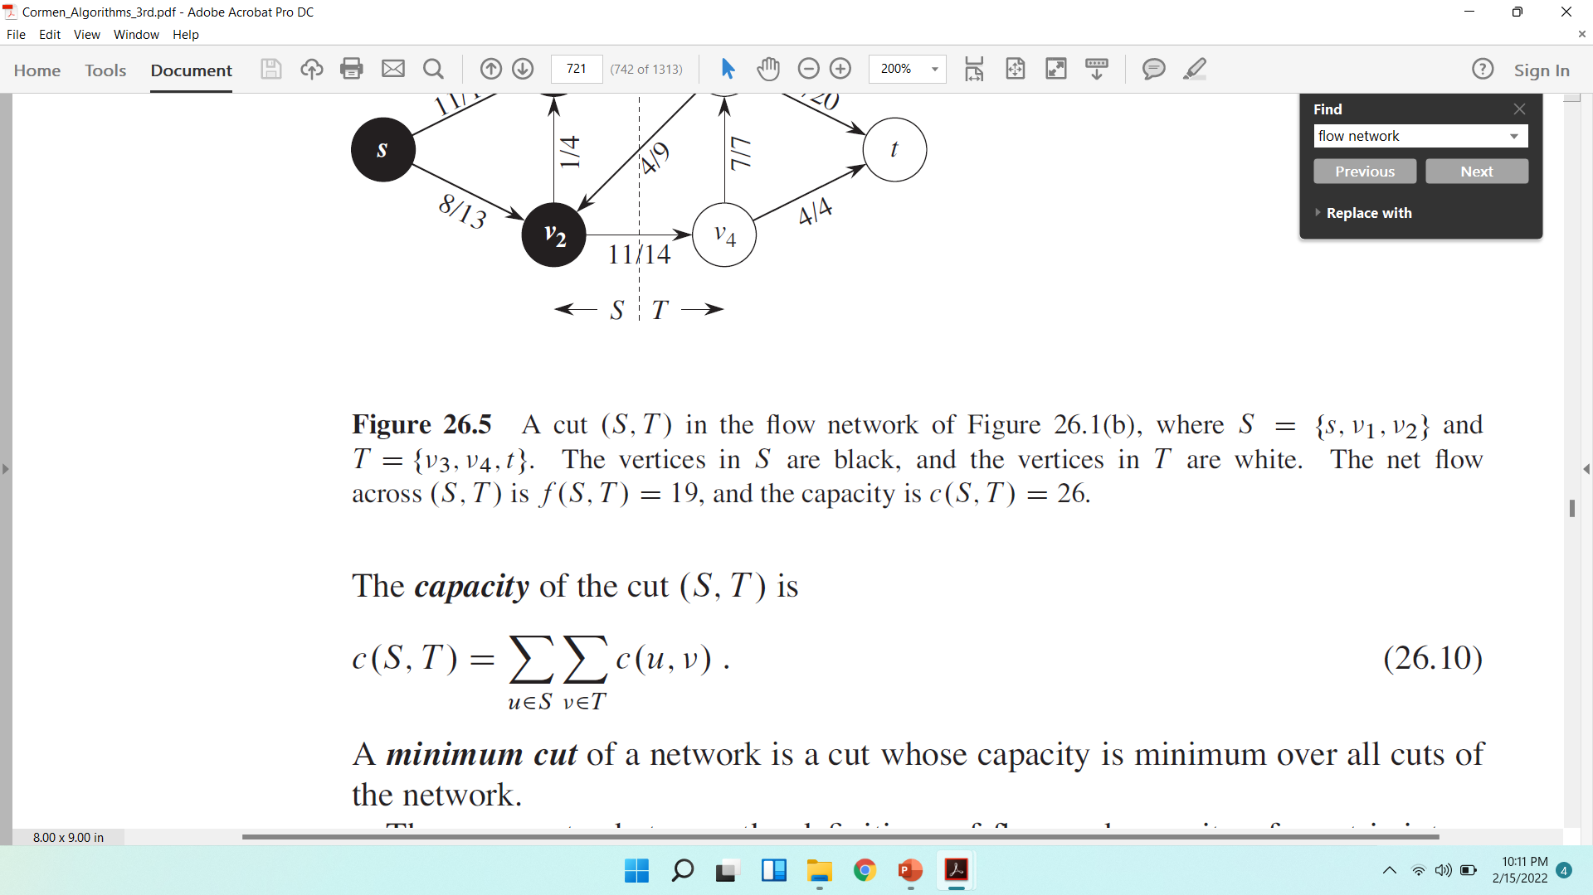

Slide 16
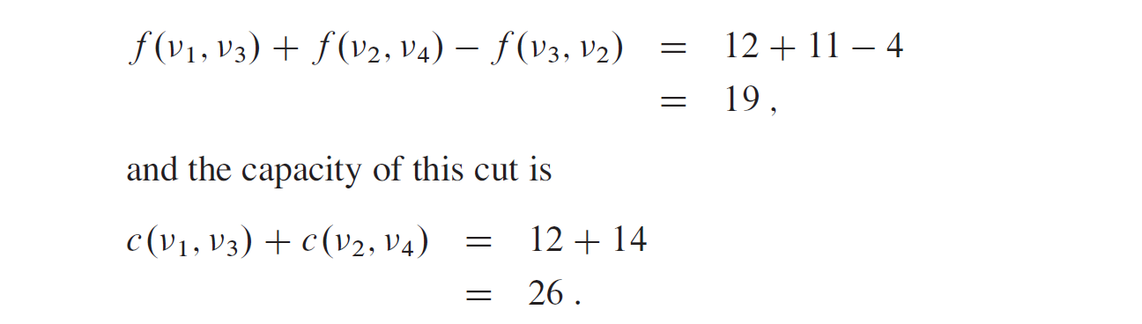
NetFlow across the cut
A minimum cut of a network is a cut whose capacity is minimum over all cuts of the network.

Slide 17
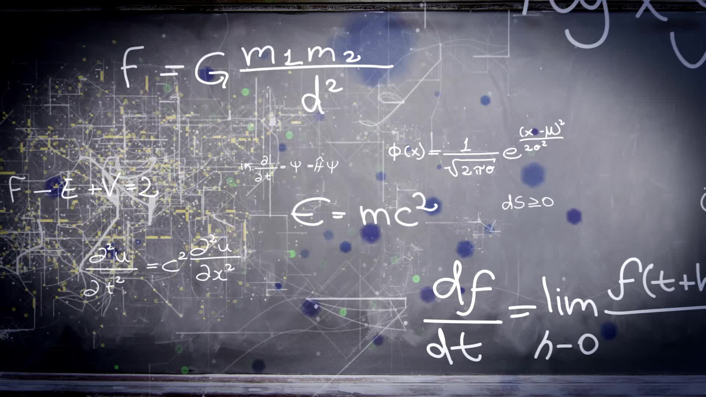
Max- Flow Min Cut Theorem

Slide 18
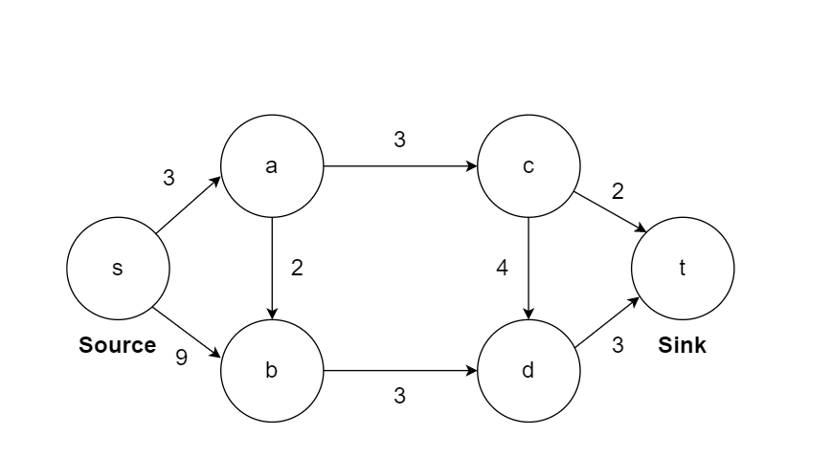

Slide 19
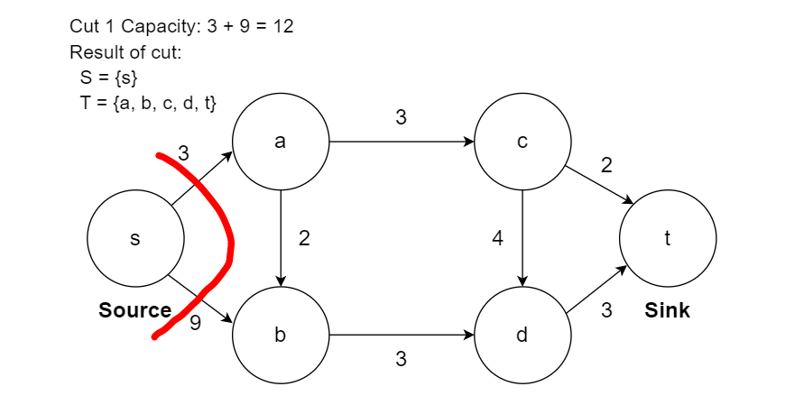

Slide 20
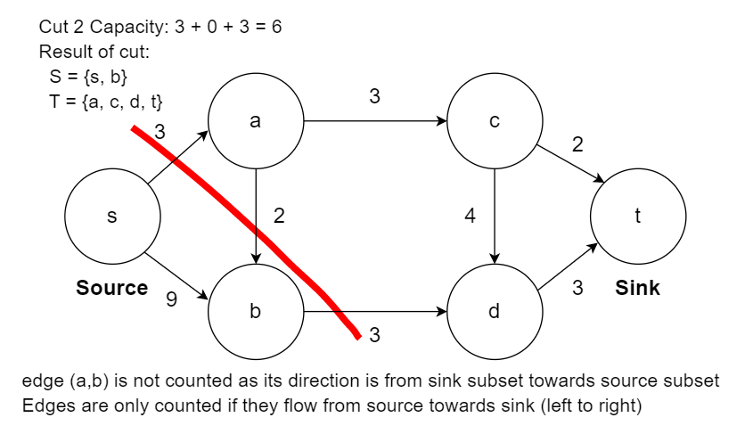

Slide 21
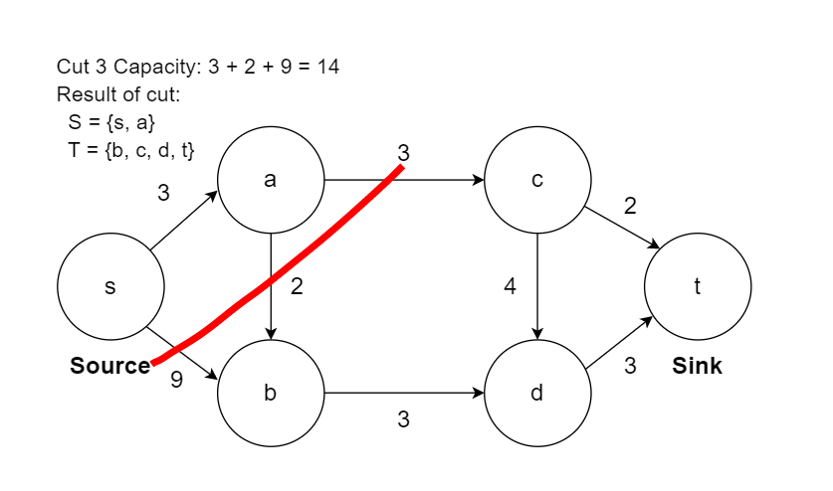

Slide 22
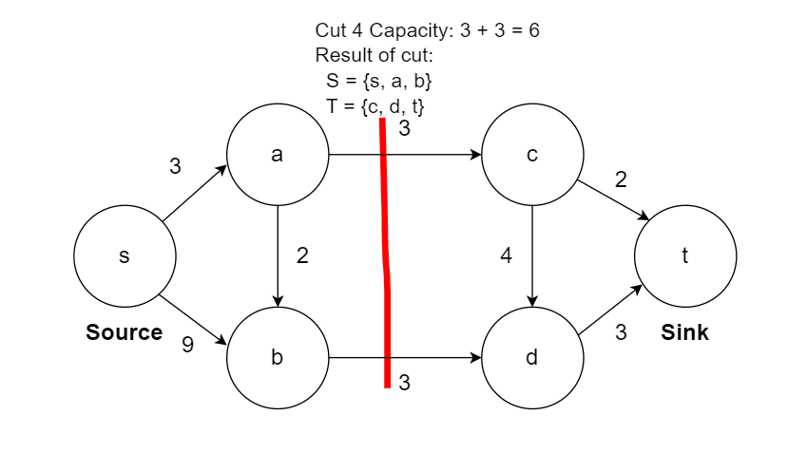

Slide 23
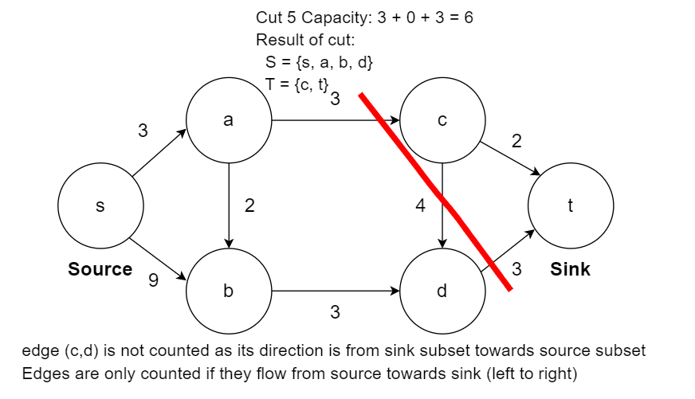

Slide 24
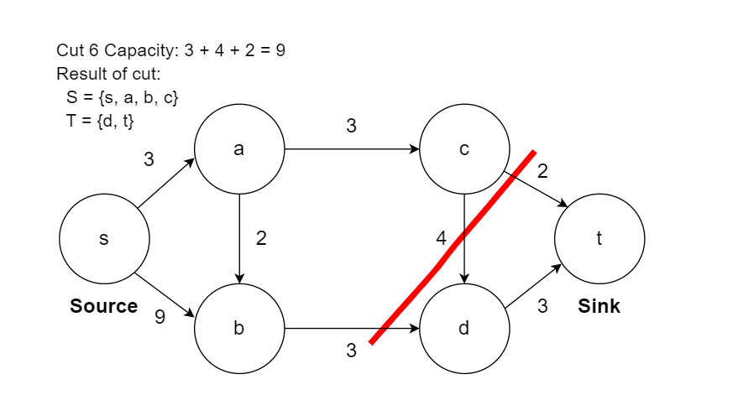

Slide 25


Slide 26

Max-Flow Min-Cut Theorem
The max-flow min-cut theorem states that in a flow network, the amount of maximum flow is equal to capacity of the minimum cut

Slide 27

Minimum Cut in a Graph
Minimum s-t Cut Problem. Minimize c(S, T), that is, determine S and T such that the capacity of the s-t cut is minimal.

